Slide 1
04 | Developing ASP.NET MVC 4 Views
Jon Galloway | Tech Evangelist
Christopher Harrison | Head Geek

Slide 2
Module Overview
Creating Views with Razor Syntax Using HTML Helpers Reusing Code in Views

Slide 3
Lesson 1: Creating Views with Razor Syntax
Adding Views Features of Razor Syntax Binding Views to Model Classes and Displaying Properties
Demo
Notes:
Though this lesson mentions alternative view engines, the course concentrates on Razor and assumes that students will use Razor for most of their MVC projects.
20486A
05: Developing ASP.NET MVC 4 Views

Slide 4
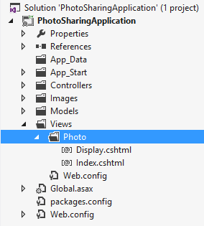
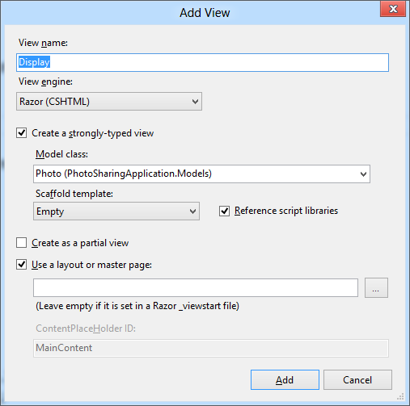
Adding Views
Notes:
Inform the students that they will learn more about layouts and master pages in Module 8 - Applying Styles to ASP.NET MVC 4 Web Applications.
Question: You are using the Razor view engine and Visual Basic to create views. You right-click the Delete action in the CustomerController.vb file. What is the name of the view file that Visual Studio will create by default?
Answer: The file name will be Delete.vbhtml unless you specify another name. It will be created in the Views/Customer folder.
20486A
05: Developing ASP.NET MVC 4 Views

Slide 5
Features of Razor Syntax
A sample code block displaying the features of Razor.
@* Some more Razor examples *@
<span>
Price including Sale Tax: @Model.Price * 1.2
</span>
<span>
Price including Sale Tax: @(Model.Price * 1.2)
</span>
@if (Model.Count > 5)
{
<ol>
@foreach(var item in Model)
{
<li>@item.Name</li>
}
</ol>
}
Notes:
Point out to the students that Razor easily differentiates content from code. For example, even within a Razor code block, when you add an HTML element such as <div>, Razor interprets the text as content. You do not usually need to use the @: delimiter to make this explicit.
Discuss the example code on the slide. Ensure that students understand the HTML that Razor will render.
Question: You want to describe a code block to developers in your view file. You do not want your description to be passed to the browser. What syntax should you use?
Answer: Declare the description as a Razor comment by enclosing it in @* *@ delimiters.
20486A
05: Developing ASP.NET MVC 4 Views

Slide 6
Binding Views to Model Classes and Displaying Properties
You can use strongly-typed views and include a declaration of the model class. Visual Studio helps you with additional IntelliSense feedback and error-checking as you write the code.
Binding to Enumerable Lists:
You can use dynamic views to create a view that can display more than one model class.
@model IEnumerable<MyWebSite.Models.Product>
<h1>Product Catalog</h1>
@foreach (var Product in Model)
{
<div>Name: @Product.Name</div>
}
Notes:
The code example in the slide shows how to use a strongly-typed view when the action controller passes a list of objects of a specific model class.
Question: You want to write a view that displays ten objects of the Photo model class. What model declaration should you use?
Answer: Use a declaration in the following form: @model IEnumerable<projectname/Models/Photo>
20486A
05: Developing ASP.NET MVC 4 Views

Slide 7
Creating Views

Slide 8
Differentiating Server Side Code from HTML
Razor identifies server-side code by looking for the @ symbol.
In Razor syntax, the @ symbol has various uses. You can:
Use @ to identify server-side C# code
Use @@ to render an @ symbol in an HTML page.
Use @: to explicitly declare a line of text as content and not code.
Use <text>to explicitly declare several lines of text as content and not code.
To render text without HTML encoding, you can use the Html.Raw() helper.
Notes:
Emphasize to the students that Razor is very sophisticated and it rarely misinterprets content and server-side code. Therefore, they will rarely use the @: and <text> delimiters.
Be very clear about the security implications of using Html.Raw() to disable HTML encoding. Emphasize that malicious users regularly test sites for weaknesses. If your use of Html.Raw() does enable script injection, a malicious user is very likely to notice and exploit the weakness.
20486A
05: Developing ASP.NET MVC 4 Views

Slide 9
Lesson 2: Using HTML Helpers
Using Action Helpers Using Display Helpers The Begin Form Helper Using Editor Helpers Using Validation Helpers
Demonstrations
Notes:
If you have students who are familiar with Web Forms, you might like to contrast MVC HTML helpers with Web Forms server controls. Helpers perform an analogous role in MVC to the role that server controls play in Web Forms. However, helpers are simpler and lighter-weight. They do not render large blocks of HTML and JavaScript code or ViewState data. Also, they do not support event handlers.
20486A
05: Developing ASP.NET MVC 4 Views

Slide 10
Using Action Helpers
Html.ActionLink()
Url.Action()
@Html.ActionLink("Click here to view photo 1", "Display", new { id = 1 })
<a href="/photo/display/1">
Click here to view photo 1
</a>
<img alt="This image came from an action" src="@Url.Action("GetImage", new { id = 1 })" />
<img alt="This image came from an action" src="/photo/getimage/1" })"
/>
Notes:
The action helpers described in this topic examine the routes defined in your web application to render the correct URLs. Students have not yet learned about the routing engine or how to modify routes. They will learn about routing in Module 7.
Question: You want to render an HTML5 <audio> tag to play a sound file from an action. Would you use the Html.ActionLink() helper or the Url.Action() helper?
Answer: You would use the Url.Action() helper because you are rendering an attribute within the <audio> tag, and not a complete <a> element.
20486A
05: Developing ASP.NET MVC 4 Views

Slide 11
Using Display Helpers
Html.DisplayNameFor()
Html.DisplayFor()
@Html.DisplayNameFor(model => model.CreatedDate)
Created Date
@Html.DisplayFor(model => model.CreatedDate)
03/12/2012
Notes:
Question: You want to ensure that a view displays “This product was last changed on” before the ModifiedDate property. This text is declared in the class with the DisplayName annotation. What code would you write in the view?
Answer: @Html.DisplayNameFor(model => model.ModifiedDate)
20486A
05: Developing ASP.NET MVC 4 Views

Slide 12
The Begin Form Helper
Html.BeginForm()
@using (Html.BeginForm("Create", "Photo", FormMethod.Post, new { enctype = "multipart/form-data" }))
{
@* Place input controls here *@
}
<form action="/Photo/Create" method="post“
enctype="multipart/form-data">
</form>
Notes:
Question: You have created a form with a file selector control that uses the GET method. You have set the enctype attribute to multipart/form-data but when you try to access the file in the action method, an exception is thrown. What have you possibly done incorrectly?
Answer: You must use the POST method to upload files.
20486A
05: Developing ASP.NET MVC 4 Views

Slide 13
Using Editor Helpers
Html.LabelFor()
Html.EditorFor()
@Html.LabelFor(model => model.ContactMe)
<label for="ContactMe"> Contact Me </label>
@Html.EditorFor(model => model.ContactMe)
<input type="checkbox" name="Description">
Notes:
Question: You have a property in the Product model class named ProductID. You want to include this in the HTML page so that client-side script can use the ProductID value. However, you do not want the value to be displayed to users. In the model class, you have annotated the ProductID property with the [HiddenInput(DisplayValue=false)] attribute. How will the Html.EditorFor() helper render this property?
Answer: The Html.EditorFor() helper renders the following HTML:
<input name="ProductID" type="hidden" value="id">
20486A
05: Developing ASP.NET MVC 4 Views

Slide 14
Using Validation Helpers
Html.ValidationSummary()
Html.ValidationMessageFor()
@Html.ValidationSummary()
<ul>
<li>Please enter your last name</li> <li>Please enter a valid email address</li> </ul>
@Html.ValidationMessageFor(model => model.Email)
Please enter a valid email address
Notes:
Remind the students that they learned how to set validation requirements in model classes by using validation data annotations such as [Required] in Module 3. They have also learned how to check the validity of user data in a controller action by testing the ModelState.IsValid property in Module 4.
20486A
05: Developing ASP.NET MVC 4 Views

Slide 15
Creating a Create Page

Slide 16
Lesson 3: Reusing Code in Views
Creating Partial Views Using Partial Views Demonstration
Notes:
20486A
05: Developing ASP.NET MVC 4 Views

Slide 17
Creating Partial Views
You can use partial views to render the same HTML content in different locations in your web application
Creating and Naming Partial Views:
Create a partial view by using the Add View dialog
Name partial views with an underscore prefix to keep to convention
Strongly-typed and dynamic partial views:
Create strongly-typed partial views if you are certain that the partial view will always display the same model class.
Create dynamic partial views if you are not sure if the partial view will always display the same model class.
Notes:
In this topic, the contents of partial views, which do not render complete webpages, are contrasted with the contents of other views, which include <body> and <head> tags for a complete webpage. If you use template views, <body> and <head> tags appear in the template, and not in the view file. In such web applications the content of views and partial views can appear similar. However, students do not learn about template views until Module 8- Applying Styles to ASP.NET MVC 4 Web Applications. Do not introduce template views in this module because this might confuse students.
Question: You want to create a partial view that displays a list of comments. The comments partial view will be called by actions in the PhotoController and the HomeController. In which folder should you create the partial view file?
Answer: You should create the partial view in the /Views/Shared folder so that multiple controllers can access it.
20486A
05: Developing ASP.NET MVC 4 Views

Slide 18
Using Partial Views
Using HTML helpers, you can use partial views within other views in a web application:
To pass the same model object to a partial view from the parent view, use Html.Partial()
To pass a model object to a partial view, which is different from the parent view or of a different model class, use Html.Action()
Use the ViewBag and ViewData collections to share data between the controller action, parent view, and partial view
Notes:
Question: You want to display user reviews of a product to each product page. You have created a _ReviewsForProduct partial view. Would you use Html.Partial() or Html.Action() to render this view?
Answer: You would use Html.Action() to render this view so that you can pass a different model object, in this case, a collection of reviews, to the partial view.
20486A
05: Developing ASP.NET MVC 4 Views

Slide 19
Creating Partial Views

